Slide 1
CS 4530: Fundamentals of Software Engineering Module 3: Unit Testing
Adeel Bhutta and Mitch Wand
Khoury College of Computer Sciences
© 2026 Released under the CC BY-SA license

Slide 2
Learning Goals for this Lesson
At the end of this lesson, you should be able to:
Explain three general ways of judging whether we've written enough tests
Explain how contracts provide better guidance than types in choosing test cases
Explain various measures of code coverage (including statements, branches, functions, and lines)
Explain how adversarial testing helps gauge whether our tests are sensitive enough to detect likely bugs
Notes:
Let’s start by discussing how TypeScript lets you document what inputs a function or program can have.

Slide 3
When have we written enough tests?
When we've tested each component with enough inputs?
When we've tested enough of our code?
When our tests are precise enough to detect likely bugs?

Slide 4
Unit tests vs. Integration tests
Unit Tests: testing a single function in isolation
Unit testing only needs to give a function tests that respect the functions preconditions: no need to test -3 or 1.4
Integration Tests: testing more than a single unit
test how parts of a program work together: that’s where we ensure other functions respect our function’s contracts.
Notes:
When we’re talking about testing a specific function, we’re really talking about writing a unit test, that tests an isolated part of a program. Other parts of the program are responsible for respecting the contracts on our function, but that’s a problem for integration testing, which we’ll talk about more in a future lecture.
It’s valid to say “we never need to write unit test inputs that violate preconditions,” and it is also valid to look at this and say “we can’t possibly trust ourselves and the evolution of our code over time — test calling the function on an invalid message ID, or passing null as the chat ID, anyway!” There’s not a single right answer.
What are the drawbacks for writing tests that violate the function’s stated preconditions? (One answer: if you write tests that violate the preconditions, that may push you to check for the precondition violation in code. Which means your code is now more slower and more complicated than it had to be!)

Slide 5
Why do we test? Because Tests are the specification (Beyonce rule)
Test Driven Development
If we start with tests, passing the tests lets us know we’re done meeting the conditions of satisfaction
Acceptance Testing
Does the customer agree we’ve met the conditions of satisfaction?
Regression Testing
Did something change since some previous version?
Prevent bugs from (re-)entering during maintenance.
“Good” test suite detects bugs that (inevitably) get added as software is developed over time: tests are for the future
Notes:
Our focus in the last lecture was on testing as part of the test-driven development process: testing is so we know when we’re done building the thing we’re building. That’s still true, but there are some other important considerations worth mentioning.
Software engineering is about developing software for people in groups over time. The assumption behind test-driven specification is that the real specification is often not written out explicitly or precisely, so often the tests are the most effective documentation of that unwritten spec, and that documentation may be all that anyone remembers when it matters.
You may have specific domain knowledge that future developers who touch the code do not (or that you will forget)
This leads to the Beyonce rule: "if you liked it you should have put a test on it". This rule recognizes that often the tests *are* the specification.

Slide 6
BUT: tests alone can't specify all of the behavior we want
Tests alone can't specify the range of inputs we expect our module to handle.
We need to understand just what code we are testing.
Tests may not specify all of the behavior that our clients expect.
Tests may not detect likely bugs in our code.
Is the behavior of our code even testable?
Nevertheless, we start writing tests in TDD

Slide 7
3.1 Have we tested enough of the inputs?

Slide 8
Contracts tell us which test cases we need
/**
* Adds a message to a chat, updating the chat
*
* @param chatId - Ostensible chat id
* @param user - Authenticated user
* @param messageId - Valid message id
* @returns the updated chat info object
* @throws if the chat id is not valid
*/
export function addMessageToChat(
chatId: string,
user: UserWithId,
messageId: string
): ChatInfo {
Requires a chatId, which may or may not be valid. Function must check for this!
Requires a Valid messageId => Function can assume validity. All test cases must always deliver valid value
Notes:
A digression: here’s a more “real” version of our example, a piece of code from the Spring 26 will codebase. Both the comments and the types are telling us about the function’s preconditions, which help set the expectations for testing the code.
The written contracts in this function’s docstring are saying that the chatId input is something that claims to be a chatId, but it might not actually represent a real chat ID. The docstring for the `messageId` argument is saying that the messageId must be a valid id that corresponds to a message in the database. (as it turns out, the code will accept any string as a messageId; there's no check to see that it is unique. (mw says: I didn't write this code. I don't know if duplicate messageIds may cause a problem ☺)
If we’re writing unit tests based on this documentation, it means we’d definitely want to test this function with a valid chat ID and an invalid chat ID. But we’re requiring that the message ID is valid as a precondition of the function, so if we’re trusting that this function will be called in ways that respect the function’s contracts, we don’t need to test it with a random string message ID that can’t possibly correspond to a message.

Slide 9
From contracts to test cases
For numerical inputs, it's pretty easy to identify test cases:
one at each end of the range
one in the middle
For searching
one where the find is successful
one where the find is unsuccessful
if the code uses loops rather than .find() or the like, then check ends of range

Slide 10
Example
/** Returns an array that repeats "hello"
* @param numHellos - number of “hello”s to return, must be an integer >= 0
*/
function helloNTimes(numHellos: number): string[] { const arr: string[] = [];
for (let i = numHellos; i !== 0; i--) { arr.push("hello"); } return arr;
}
What input values do I need to test this function on?
Edge cases (definitely 0)
Probably 1 and some larger number? But most numbers > 1 are kind of interchangeable => “equivalence classes”
What about -3? 1.4? NaN? null? { lol: 'owned' } ?
Notes:
Mention: “kind of interchangeable” has a formal name, “equivalence classes of inputs.”
There are two types of contracts in this function: the TypeScript one says that the input must be a number, and the one document in the precondition that says that it must be a nonnegative integer.

Slide 11
Why not just rely on types?
TypeScript is helpful, but it’s obviously only providing help in making sure that the function gets 3 and not “three”. It’s not going to help with 3 versus 3.1 or -8 or NaN.
/** Returns an array that repeats "hello"
* @param numHellos - number of “hello”s to return, must be an integer >= 0
*/
function helloNTimes(numHellos: number): string[] { const arr: string[] = [];
for (let i = numHellos; i !== 0; i--) { arr.push("hello"); } return arr;
}
Notes:
Having contracts checked by code is, generally, good! TypeScript helps us check some of our contracts, but obviously we may have preconditions that aren’t expressible in TypeScript.
There’s an important caveat, however!

Slide 12
TypeScript Types Are Easily Circumvented (1)
In a language like Java, we’d need to worry that another function could call helloNTimes with -3: calling the function with a string or null is a compiler error.
That’s not true in TypeScript, and that can be surprising.
/** Returns an array that repeats "hello"
* @param numHellos - number of “hello”s to return, must be an integer >= 0
*/
function helloNTimes(numHellos: number): string[] { const arr: string[] = [];
for (let i = numHellos; i !== 0; i--) { arr.push("hello"); } return arr;
}
Notes:
This is a critical point about TypeScript, and one that can be really surprising at first.
In Java, we’d need to be concerned that some malicious function would call an analogue of “helloNTimes” with a negative number, but there’d be no way to call it with a value of some completely unexpected type: Java would never allow such a thing to happen.
That’s not true about TypeScript

Slide 13
TypeScript Types Are Easily Circumvented (2)
In a language like Java, we’d need to worry that another function could call helloNTimes with -3: calling the function with a string or null is a compiler error.
That’s not true in TypeScript, and that can be surprising.
TypeScript will happily accept the following as a well-typed expression:
helloNTimes({ lol: 'owned ' } as unknown as number)
Types do seem to make it less likely you’ll screw up accidentally…, and ESLint + TypeScript work together to help prevent such accidents.
Notes:
Unlike some languages, the type contracts in TypeScript are totally unchecked — Node will happily run the function with an argument that is not a JavaScript number at all, just as it will happily run it on an input that violates the “nonnegative integer” contract in the precondition. Node will run code even if TypeScript says it’s bad!
But it’s even worse: no matter how picky you make TypeScript, it can be pretty easily convinced to ignore obvious type errors, such as this one. This is fundamental to TypeScript, but can be very confusing if you’re used to types in languages that aren’t Python and JavaScript.
So why are we using TypeScript at all? Well, a lot of people obviously find a lot of value in using TypeScript, and we’re using it in this course for a reason. The reality is that different software projects use TypeScript in fundamentally different ways. It’s possible, in most cases, to make choices in a project that make mistakes less likely. In general, the more you utilize TypeScript type to prevent violating a function’s contracts, the faster you’ll find bugs, and the less you’ll need to rely on your integration tests to find issues.
Our project code sets up the ESLint linter with a lot of rules that enforce this strict use of TypeScript.

Slide 14
Some Libraries Use any: Common But Dangerous
import express from 'express';
const app = express();
app.use(express.json());
type Auth = { username: string; password: string };
app.post('/', (req, res) => {
const auth: Auth = req.body;
if (auth.password !== 'secret') {
res.status(403).send({ error: 'Wrong password' });
} else {
res.send({ message: `WELCOME,${auth.username.toUpperCase()}` });
}
});
app.listen(8000, () => console.log(`Listening on port 8000`));
This has type “any” 😭
We'll talk about how to handle this safely in Module 04
Notes:
Here’s a small webserver that uses Express, the same library that the course project uses.
The third line where we “use” express.json() covers an enormous amount of validation — it ensures that our web server will only respond to specific requests that send JSON data (we’ll be using JSON data a lot in the class, there’s an article about it in the resources for this lecture)
(click)
However, the line that lets `req.body` be treated as an `Auth` (where the second arrow is pointing) has some really unfortunate typescript happening. If you read this line, it looks like you’re now able to trust that the request body matches the `Auth` type. But this is not true. This line only works in Typescript because the express library treats untrusted request bodies as “any”, not as “unknown.” This makes the express server a lot easier to use… and also makes it a lot easier to make errors. It’s would have been better design for express to treat req.body as 'unknown’.
(History: the unknown type was only added to TypeScript in 2018, and the TypeScript spec for express dates back to at least 2012 — https://github.com/DefinitelyTyped/DefinitelyTyped/commit/a6f2316773e0456d947381afb7683a7ac6548e24 , specifically. So express uses the any type as another artifact of maintaining software over time.)
Given how complicated we just saw it was to make sure that an unknown input had the correct format, this decision mostly makes sense.
(Optional Q: what input would cause an exception that typescript would seem to make impossible? See next hidden slide)

Slide 15
Property-based tests can specify a range of inputs
import { fc, it } from "@fast-check/vitest";
import { describe, expect } from "vitest";
import { someRoot } from "someRoot.ts";
/**
const coefficient = fc.integer({ min: -50, max: 50 });
const nonZeroCoefficient = coefficient.filter((a) => a !== 0);
/** Number of decimal places that `toBeCloseTo` should agree to. */
const TOLERANCE = 6;
describe(`quadraticRoots()`, () => {
// it.prop declares a property-based test,
// The first argument is an array of arbitraries,
// and the second argument is the name of the test
// + a function that takes the generated values as arguments.
// The arbitraries carry enough information to assign types to a, b, and c,
// so the function can be type-checked.
it.prop([nonZeroCoefficient, coefficient, coefficient])(
"another syntax for the same test",
(a, b, c) => {
const x = someRoot(a, b, c);
expect(a * x * x + b * x + c).toBeCloseTo(0, TOLERANCE);
},
);
});
// https://www.npmjs.com/package/@fast-check/vitest

Slide 17
Review of Section 3.1
One view of TypeScript is that it’s a handy way of documenting, and imperfectly checking, the contracts (preconditions and postconditions) of your code
Do you need to test inputs that violate your contracts? It depends on the context
Some libraries (particularly Express) give dangerous types
Notes:
There’s not a good answer to whether you need to test inputs that violate your contracts!
But you can’t trust anything that you’re receiving from the user over a network connection, even if the webpage prevents certain user actions. Many, many security vulnerabilities are just people getting this wrong.

Slide 18
3.2 Have we tested enough of the code?
Easy part: identifying how much code we're exercising (Code Coverage)
Harder part: identifying what code might have caused a test failure (Test Isolation)

Slide 19
Code Coverage
The industry standard answer for “have I written enough tests”
Measures “how much of your code” is exercised by your tests
If none of your test even execute a piece of code, it’s not being tested!
Notes:
That talks about what our goals are for writing enough tests. In most software engineering applications, when we measure whether we’re writing good tests, we are talking about measuring code coverage.
Measuring code coverage is based on a really simple thought: if you’re not running code, you’re not testing it.

Slide 20
Code Coverage: Line or Statement Coverage
Line and Statement coverage are a coarse measurement.
Testing x = 0 exercises lines 2 and 3
Testing x = 10 exercises lines 2, 5, 6, and 7.
1| export function f(x: number) {
2| if (x === 0) {
3| return 3;
4| }
5| const y = x > 4 ? 2 : 3;
6| const z = x % 2 === 0 ? 1 : 2;
7| return x / (y - z);
8| }

Slide 21
Code Coverage: Branch Coverage
Branch coverage: widely used in industry.
Testing with x > 4 and x <= 4 necessary to handle both branches on line 5.
Testing with odd and even numbers necessary to handle both branches on line 6.
The values -2, 0, 1, and 10 get full branch coverage.
1| export function f(x: number) {
2| if (x === 0) {
3| return 3;
4| }
5| const y = x > 4 ? 2 : 3;
6| const z = x % 2 === 0 ? 1 : 2;
7| return x / (y - z);
8| }

Slide 22
Code Coverage: Path Coverage
The values -2, 0, 1, and 10 get full branch coverage…
…but 5 causes line 7 to divide by zero!
In JavaScript/TypeScript, this doesn’t cause an exception, there’s a number called “Infinity” (which is different from “NaN,” for “not a number”)
Path coverage covers all combinations of branches; it is infeasible in practice.
1| export function f(x: number) {
2| if (x === 0) {
3| return 3;
4| }
5| const y = x > 4 ? 2 : 3;
6| const z = x % 2 === 0 ? 1 : 2;
7| return x / (y - z);
8| }

Slide 23
Code Coverage: Example 1
What tests will get line/branch/path coverage here?
/** Returns an array that repeats "hello"
* @param numHellos - number of “hello”s to return, must be an integer >= 0
*/
function helloNTimes(numHellos: number): string[] { const arr: string[] = [];
for (let i = numHellos; i !== 0; i--) { arr.push("hello"); } return arr;
}
Notes:
(Answer: just the input 1 will get line coverage and branch coverage. That’s not great! But path coverage would take an infinite number of tests. This metric isn’t perfect!)

Slide 24
Code Coverage: Example 2
What tests will get line/branch/path coverage here?
const zHelloInput = z.int().gte(0);
/** Returns an array that repeats "hello"
* @param numHellos - number of times to say “hello”
* @throws if the input is not an integer >= 0
*/
function helloNTimes(numHellos: unknown): string[] {
// throws if the input is not an integer >= 0 const parseResult = zHelloInput.safeParse(numHellos);
if (!parseResult.success) throw new Error("Invalid input");
const arr: string[] = [];
for (let i = parseResult.data; i !== 0; i--) { arr.push("hello"); } return arr;
}
Notes:
In the version of helloNTimes that gets untrusted inputs, there’s an extra branch that needs to be tested: we need to give at least a valid and invalid input.

Slide 25
Code Coverage and “edge” cases can be related
Some of our intuition about “edge cases” can be understood in terms of trying to imagine inputs that will provide code coverage for an unknown function.
BUT: code coverage won’t tell you to check 0 specifically if there’s a branch that checks x >= 0
Thinking about the “edge case” of a branch is a good move
What inputs should we start with if:
We’re taking numbers that are supposed to represent a 5-digit zip code?
We’re taking strings that are supposed to represent a 5-digit zip code?
We’re taking an array of strings that represent people’s names?
Notes:
Possible answers:
numbers too large or small to be zip codes, zip codes that start with one or more zeros
Strings too short or two long to be a 5-digit zip code, 5-digit numbers that are and are not valid zip codes, 5-character strings that aren’t all digits
Arrays that are empty, that contain duplicate names, that contain all unique names, that are sorted or not

Slide 26

Code Coverage in Vitest
Tools like vitest makes it easy to check code coverage

Slide 27
Review of Section 3.2
Total code coverage — by any metric — does not mean no bugs
Running code doesn’t mean checking that it’s doing the right thing! (important to Assemble/Act/Assess)
“Coverage is no substitute for thought” — Rob Pike
Coverage checking can be invaluable at identifying when you think you’re testing something but you’re not, which is a real problem in practice.
Test-Driven Development also valuable for this problem: it’s important that tests switch from failing to succeeding when you expect them to
Notes:
(Rob: I’ve been saved more than once by trying to intentionally break my code and noticing that the test I expected to fail didn’t fail — this meant the test wasn’t checking what I expected it to!)

Slide 28
Test Isolation
If a test fails, any code that the test executes may have caused the failure.
Useful heuristic: any test case actually tests everything that it mentions (and everything that those things execute)
Bigger footprint => better coverage
Smaller footprint => better isolation

Slide 29
3.3 Are our tests sensitive enough to detect likely bugs?
Notes:
The first answer we give, when I’ve described all the valid inputs, motivated some more discussion of TypeScript.
The future focus of regression testing is what motivates the last two answers:
The second answer is based on code coverage, a very common metric of test adequacy in modern software engineering.
The third answer is pretty direct: we’ve written enough tests when the tests will catch bugs!

Slide 30
Adversarial Testing
It can be helpful to think of testing as a game in which you play against an adversary.
Your adversary plays by producing multiple versions of the code ("mutations")
Some of these may change the behavior of your system in acceptable ways, and some of these introduce actual ugs.
You get to decide which of the mutations are actually buggy
Your win if your tests catch all the buggy mutants, and pass all the acceptable.
Notes:
When we need a graph to measure “have we written enough tests,” code coverage is absolutely what everyone uses. But we’ve just seen a couple of ways that this can fail to tell us that we’ve written enough tests — or at least, fail to tell us when our tests are any good.
A much more robust way to think about the question of have I written enough tests is the idea of adversarial testing. Could someone else write a buggy version of your code that your tests would fail to catch?

Slide 31
Who is the adversary?
It could be a bot
It could be an inattentive or malicious member of your team

Slide 32

Stryker is a tool for automated adversarial testing
Original code (correct)
// find the first item in the list that is
// greater than or equal to the target.
export default function search(list:number[], target:number) {
return list.find((item) => item >= target);
}
Mutated code (buggy)
// find the first item in the list that is
// greater than or equal to the target.
export default function search(list:number[], target:number) {
return list.find((item) => item > target);
}
Notes:
Here’s an example of a function that has an error that you might make if you were in a hurry, or tired, or it was late at night.
Snidely Whiplash (over there on the right) asks "can your tests tell that something went wrong"?
Q: can think of a test that would catch the error (search([1,2,3],2) — will return 3 instead of 2)
Q: can you think of a test that would fail to catch the error (search([1,2,5], 3) — will correctly return 5)
Would the failing test ace our code coverage tests (yes!)

Slide 33
Remedy: you need to devise tests that distinguish the original code from the mutants
If your tests pass on the buggy mutants, you need to devise a test that your original code will pass, but the mutant will fail.
Notes:
<read slide>

Slide 34
A tiny example
Imagine that this is the code to be tested
// find the first item in the list that is
// greater than or equal to the target.
export default function search(list:number[], target:number) {
return list.find((item) => item >= target);
}
and we have written some tests.
Notes:
Let's look at a tiny example. <Read Slide> Next, let's look at the Stryker report for this example.

Slide 35
Stryker report for this test
[Survived] EqualityOperator
src/for-midterm/adrian.ts:4:32
- return list.find((item) => item >= target);
+ return list.find((item) => item > target);
Tests ran:
search should return the first item in the list that is greater than or equal to the target
[Survived] ConditionalExpression
src/for-midterm/adrian.ts:4:32
- return list.find((item) => item >= target);
+ return list.find((item) => true);
Tests ran:
search should return the first item in the list that is greater than or equal to the target
The location of the mutation
The tests that were run on this piece of code
Notes:
Here is the actual Stryker report for my initial set of tests. (There was actually only one test in my suite, but that doesn't make a difference)
Let's look at each of these mutants in turn. Point out: the location of the mutation; the titles of the test(s) that covered this location (in this case, there was only one test, so they are both the same).

Slide 36
Let's look at the second one:
[Survived] ConditionalExpression
src/for-midterm/adrian.ts:4:32
- return list.find((item) => item >= target);
+ return list.find((item) => true);
How does this mutant behave differently from the original?
Answer: This mutant always returns the first element of the list
Remedy: Add a test that searches for something that is NOT the first element in the input?
Notes:
When do these code fragments behave differently? How could we give the program an input that makes the mutant fail?.
Discuss.
Ans: the mutant always returns the first element of the list. You could distinguish them by giving an input that should return some other element of the list

Slide 37
Here's one test that will cause the mutant to be killed.
test("should return the second element of the list", () => {
expect(search([5, 7, 9], 6)).toBe(7);
});

Slide 38
What about the other mutant?
[Survived] EqualityOperator
src/for-midterm/adrian.ts:4:32
- return list.find((item) => item >= target);
+ return list.find((item) => item > target);
How does this mutant behave differently from the original?
Answer: This mutant returns the first element of the list that is larger than the original
Remedy: Add a test where the input list included an “equal” item before a larger item
Notes:
Under what conditions will these two program fragments behave differently? How could we write a test to create those conditions?
DISCUSS.
ANS: if the target is equal to one of the list items, the second one will keep going and return a different one.

Slide 39
Here's one test that will catch that mutant
test("try target that is equal to some item in the list", () => {
expect(search([5, 7, 9], 7)).toBe(7);
});
Notes:
We've made the mutant fail, but our correct program succeeds.

Slide 40
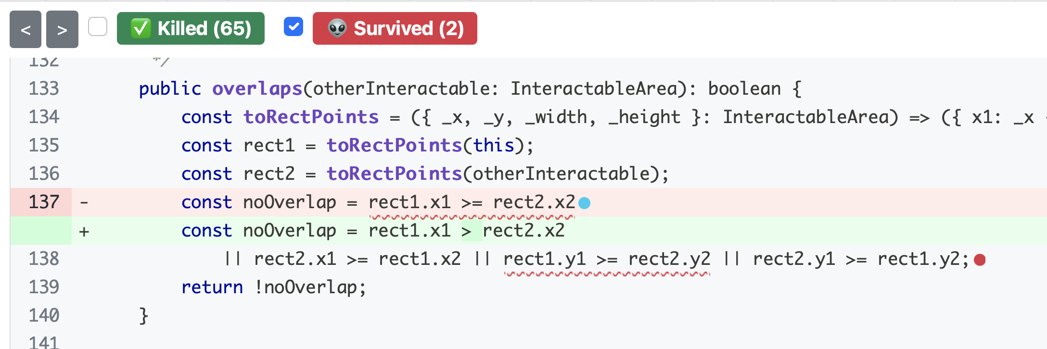
Use Mutation Analysis While Writing Tests
When you feel “done” writing tests, run a mutation analysis
Inspect undetected mutants, and try to write tests that will make those mutants fail.
Detailed mutation report for “overlaps” method - two mutants were not detected!
Notes:
Mutation analysis helps us improve our tests as we write them, because it shows us changes to our code (potential bugs!) that our tests do not detect. Remember, that to “detect” a mutant means that at least one test in your test suite fails when run on the mutated code.
Stryker actually reports both in plain text form, as we showed before, and as a handy html page. Here is a piece of the html report, running on an 'overlaps' method from Covey.town (our project from last year). In this screenshot, we can see an undetected mutant, on line 137. The red highlighting (with the minus sign) shows how the line was before the mutation, and the green highlighting (with the plus sign) shows the line after the mutation. In this case, the mutation was to replace a >= with a > sign.
There is also an undetected mutation on line 138, but it is not expanded (the red dot). When working through the report, you'll see them a single mutant at a time (because that’s what was run – one mutant at a time).
Was this a bug? I don't know, because I don't have enough context to decide ☺. But when you are running Stryker, you *will* know the context.

Slide 41
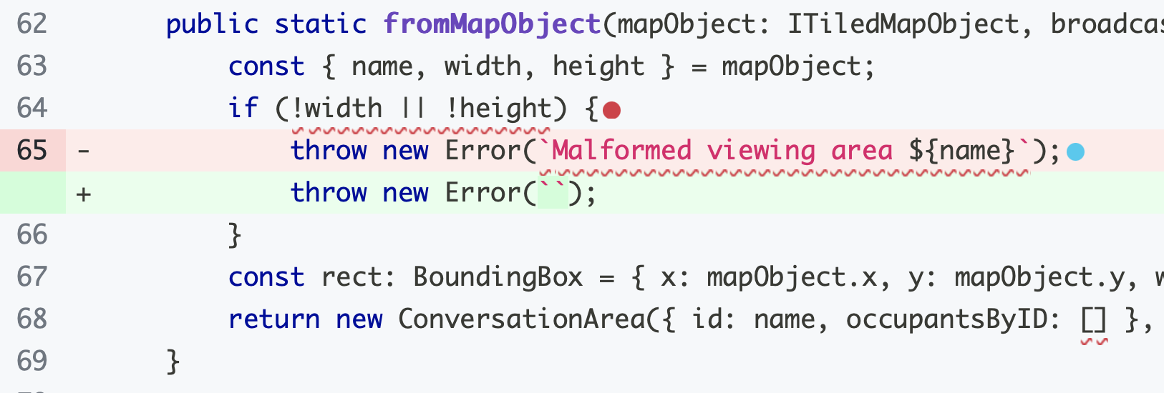
Adversarial Testing and Overspecification
Stryker is a mutation tester for JavaScript — an automated adversary!
Sometimes it loses the game because mutants aren’t bugs.
Notes:
Adversarial testing is a game, and sometimes your adversary loses the game because the “mutant” isn’t a bug.
If the spec is just “throw an error if the width or height is nonzero” then this change is fine.
This is related to a real problem with tests: they can be overspecified, and can test properties of your program you don’t actually care about. In the Tic-Tac-Toe example in your homework, the tests have to be carefully written, because it doesn’t matter whether you describe a winning line as ([[0,0], [1,1], [2,2]]) or ([[1,1], [0,0], [2,2]]).
Overly-specific tests aren’t generally a huge problem, but they can lead to flaky tests — imagine a tic-tac-toe program has randomness, and some of the time it reports solutions in a different order, so your fail… some of the time. (We’ll return to this idea in a later lecture.)

Slide 42

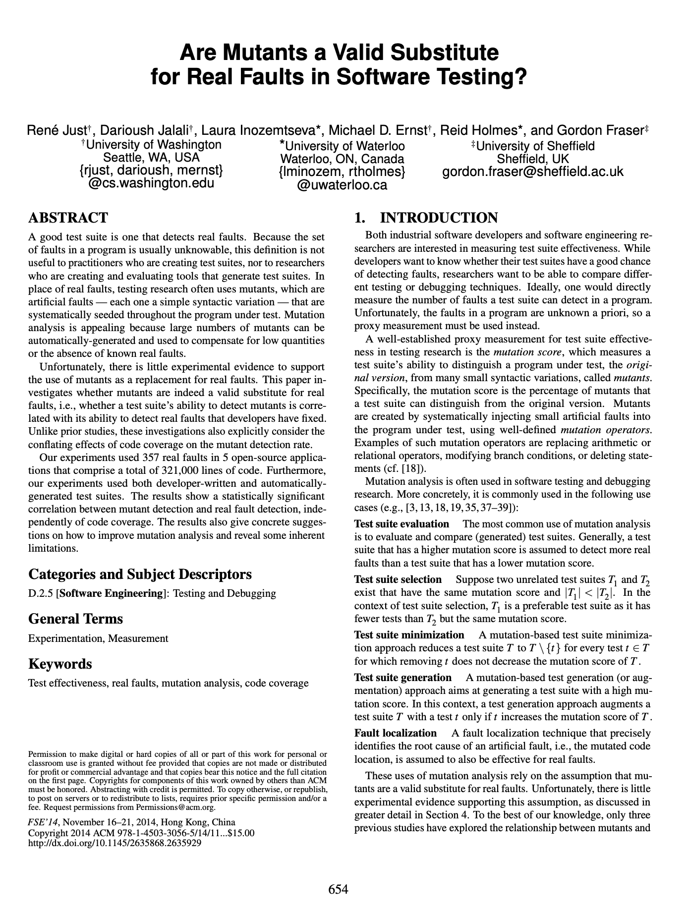
Are mutants a Valid Substitute for Real Faults? Probably yes.
Do mutants really represent real bugs?
Researchers have studied the question of whether a test suite that finds more mutants also finds more real faults
Conclusion: For the 357 real faults studied, yes
This work has been replicated in many other contexts, including with real faults from student code
Notes:
You might look at these mutants, which are caused by such simple operations, and wonder: but do these one-line mutations really represent the kinds of bugs that occur in real software? Because ultimately, that is what we are looking to evaluate, right? Do our tests find real bugs?
This study (and others that have replicated it) is important because it shows that this process of enhancing a test suite to detect more mutants might be worth the effort, because there is empirical evidence that: given two test suites, where one detects more mutants than the other (on the same SUT — System Under Test), the one that detects more mutants also finds more real bugs.

Slide 43
Review
It’s the end of the lesson, so you should be able to
Explain three general ways of judging whether we've written enough tests
Explain how contracts provide better guidance than types in choosing test cases
Explain various measures of code coverage (including statements, branches, functions, and lines)
Explain how adversarial testing helps gauge whether our tests are sensitive enough to detect likely bugs
Notes:
When have you written enough tests?
If you’re trying to make a graph or report progress to your boss — if you have tests that Assemble/Act/Assess and have 100% branch coverage, you’ve written enough tests.
If you really care about tests that do a good job making sure your code is correct, now and in the future: if your tests will always win the “game” of adversarial testing and find a bug in any buggy implementation.

